Slide 1

Researcher ID : 2020-175
Sri Lanka Institute of Information Technology, Malabe
2020.01.29

Slide 2

CONTENT
Research Problem and Solution
Objective and Sub Objective
System Overview Diagram
Methodology
Other Similar researches are
Technologies to be used
References
Budget

Slide 3

Research Information.
Group ID - 2020-175
Research Domain - Robotics and Intelligent Systems
Project Title - Sinhala Conversational Appointment Management System for Medical Domain
Supervisor - Prof. Koliya Pulasinghe
Co Supervisor - Ms. Vijani Piyawardana

Slide 4
Member Information
Student ID | Student Name | Role | Specialization
IT16234062 | Rajapakshe D.D.S | Leader | BSc (Hons) in Information Technology Specialising in Information Technology
IT17029278 | U.L.N.P. Uswatte | Member | BSc (Hons) in Information Technology Specialising in Information Technology
IT17255820 | Kudawithana K.N.B | Member | BSc (Hons) in Information Technology Specialising in Information Technology
IT17043656 | Nishshanka N.A.B.D | Member | BSc (Hons) in Information Technology Specialising in Information Technology

Slide 5
Introduction
D.D.S Rajapakshe
Through this Sinhala conversational mobile application, mainly patients can make appointments for e-channelling and get information about User, Doctor, Channel, Hospital and Appointment details.
Notes:
Automated Convectional Mobile app using can get an appointment with doctors, and the system will be an Assistant to a patient. The system will provide a Doctors, Channel, Hospital and Appointment details to the patient

Slide 6
D.D.S Rajapakshe
Problem :
Automated conversational appointment management system for sinhala users.
In Sri Lanka Dosen’t have any Automated conversational appointment management system for sinhala users.
Solution :
Notes:
patient assistance mobile App compatible with a user voice

Slide 7
Outcome
D.D.S Rajapakshe
Develop a two Mobile Application interface. ( patient Assistant App & Medical service centres Registration App )
Compatible with Sinhala Voice command
Story bode

Slide 8
Objective
D.D.S Rajapakshe
Automated Doctor Appointment Management System for medical domain in Sinhala user(ADAMS).

Slide 9
Sub Objective
D.D.S Rajapakshe
Natural Language Process
Connecting an NLU into Rasa framework
Understanding user Natural Language
Dialogue Management
1
D.D.S Rajapakshe
2
Kudawithana K.N.B
3
U.L.N.P. Uswatte
4
Nishshanka N.A.B.D

Slide 10
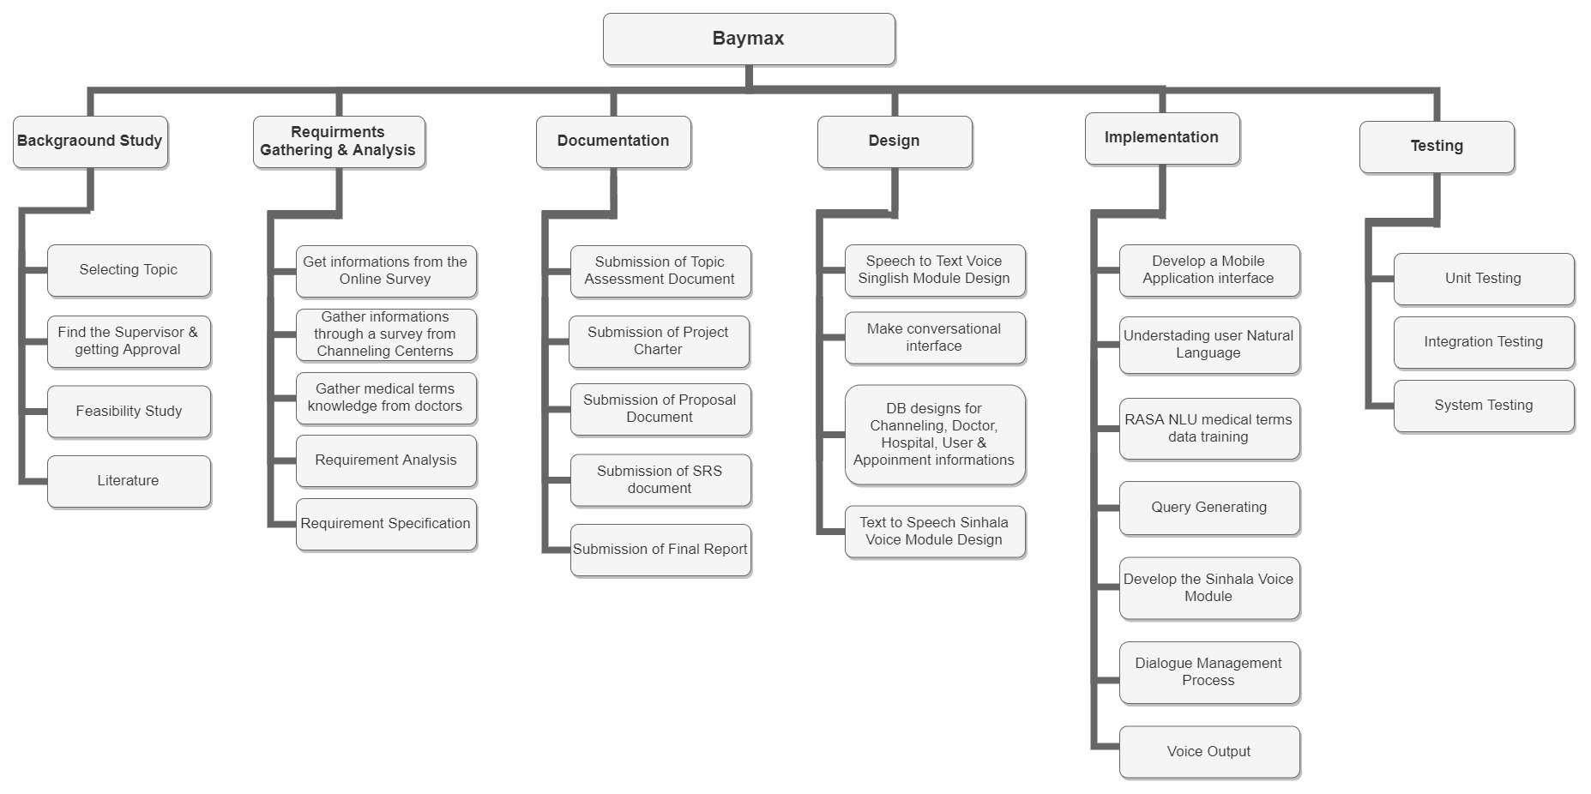
Work Breakdown Structure
D.D.S Rajapakshe

Slide 11
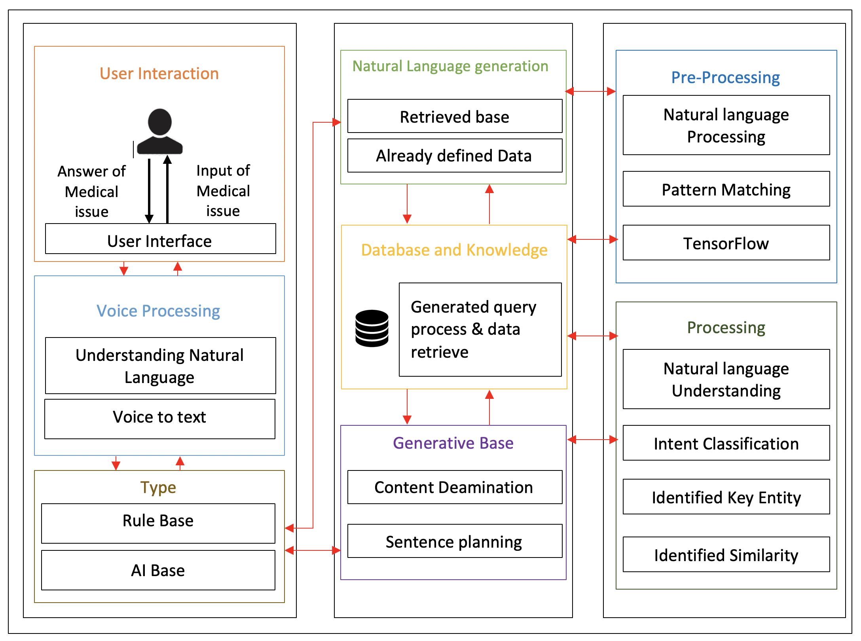
System Overview Diagram
D.D.S Rajapakshe

Slide 12
D.D.S Rajapakshe
1. Understanding user Natural Language

Slide 13
1.1 Methodology
D.D.S Rajapakshe
Understanding Patient Natural Language.
Voice to text(Google cloud API)
Dictionary (Sinhala Singlish & English) Ex : උණ -> uNa & fever
Converter (k-means clustering algorithm)
User Validation (Email Verification, Face Recognition, Encrypted Photo verification, Fingerprint Scanner )
Connectivity (RASA Framework and Flutter Mobile app SDK)
Notes:
7 function

Slide 14
Algorithm
D.D.S Rajapakshe
k-means clustering algorithm
unsupervised learning
Point similarities and dissimilarities
Use to grouping a data.
X = Data Base Value
Y = Text input
Y -Value

Slide 15
1.1) Overview Diagram
D.D.S Rajapakshe
RASA / Flutter Connectivity with Mobile Platform
Email Verification
Face Recognition
Encrypted Photo verification
Finger Print Scanner
User Identification
Voice to Text
patient Voice
Google Speech text API
Sinhala Text
Singlish Text to Sinhala Text
Sinhala Text to SinglishText
Converter (rule-based implementation)
English Text
Data Base Knowledge

Slide 16
1.2) Research Gap
D.D.S Rajapakshe
Function | Gap | Implement Technology
Understanding Patient Natural Language | Yes | Helakuru
Voice to text | Yes | Google cloud API
User Validation | Yes | All Mobile app
Dictionary(Singlish) | No | -------------------------
Converter | No | -------------------------
RASA Framework connectivity with Flutter (Voice) | No | -------------------------
DataBase connectivity with firebase and RASA | NO | -------------------------

Slide 17
2. Natural Language Process
K N B Kudawithana

Slide 18
2.1) Overview Diagram (NLP)
K N B Kudawithana
Singlish Sentence
Filter the medical Domain Facts and Database creation
User Information
Doctor Information
Channel Information
Hospital Information
Appointment Information
Generate Query with important facts
Create, Insert, Update Delete Query
Search Query, Process Successful massage
Query will be pass to Dialogue creation

Slide 19
2.2) Methodology
K N B Kudawithana
Natural Language Processing: Identifying Given Singlish Sentences
Create Database: Database creation using NoSQL(Firebase)
Fact Identification(NLP): Filter Medical domain facts from given Singlish Sentences comparing given data set in Database
Query Generation: Generate Query from Separated medical facts and create query for them
Creation
Insert
Update
Search
Delete
Block Chain: When create user appointment create block chain
Flutter Application: Create Flutter Application for Medical Centre Registration.

Slide 20
2.3) Research Gap
K N B Kudawithana
Function | Gap
Fact Identification(NLP) using given Singlish sentence | Sort important facts from given sentence Gradient Algorithm for Sort words from Python(Gradient Based Learning Applied to Document Recognition)
Query Generation from selected facts using NoSQL | Generate a query to Wiki data using SPARQL Wrapper(La Liga Chat Bot)
Make appointments with Block Chain technology | For registrations use block chains for open distributed ledger that can record transactionsas secure manner(Personalizing Healthcare Using Blockchain Technology)

Slide 21
U.L.N.P. Uswatte
3. Dialogue Management

Slide 22
U.L.N.P. Uswatte
3.1) Overview Diagram
Generated Query with important facts
Create the Dialogue
Using Singlish and Sinhala converter convert to dialog into Sinhala text
Send Sinhala Dialogue to RASA NLU
Convert Sinhala Sentence into Speech
(Text to Speech)
Develop the Sinhala Model

Slide 23
3.2) Methodology
U.L.N.P. Uswatte
Create Singlish Sentence : Using Singlish important facts in the Query, create the Singlish sentence
Dialogue Implementation : Implement the dialogue from created Singlish sentence
Sentence Conversion : This Singlish sentence should convert into Sinhala sentence using Singlish - Sinhala converter
Created Sinhala sentence will be sent to the RASA NLU process
Implementation of Sinhala Model
Sinhala Voice : Voice Output will be generating as the response to the patient’s medial question

Slide 24
3.3) Research Gap
U.L.N.P. Uswatte
Function | Gap
Sinhala voice module generate using recorded audio. | Developing a new voice model using MaryTTS. Building a new voice model using Festvox
Dialogue generation using query responses. (Sinhala) | Sinhala voice to convert text to speech using a unit selection mechanism in MaryTTS framework. Sinhala TTS based on diphone concatenation approach using Festival framework
Generate the voice output according to the dialogue. (Sinhala) | Pronunciation dictionary and text sentence corpus having with MaryTTS framework. The MS-SAPI compliant Sinhala voice is accessible via any speech enabled Windows application

Slide 25
4. Connecting an NLU into Rasa framework
Nishshanka N.A.B.D
Convert Dialogue into the Json format
Json format move to the RASA NLU
RASA NLU connected to the RASA core
RASA Core connected to the Flutter interface

Slide 26
4.1) Overview Diagram
Nishshanka N.A.B.D
Dialogue
Jason Format
RASA NLU
Flutter Interface
RASA CORE

Slide 27
4.2) Methodology
Nishshanka N.A.B.D
Format Identification: Understanding the most suitable format which move to the RASA NLU
Markdown Format
JSON Format
JSON Format : Training the dialogues into the entity and intents
RASA NLU : Extract the entities and intents which are in json format into RASA NLU
RASA Core : Handles the conversation flow, utterances, actions and extract the RASA NLU inside this.
Flutter Interface: Connect RASA Core with Flutter Interface

Slide 28
4.3) Research Gap
Nishshanka N.A.B.D
Function | Gap
Convert Dialogue into the Json format | Convert English Dialogue into the Json format(La Liga chatbot)
RASA NLU connected to the RASA core | Rasa NLU analyses the English sentence and returns a human readable json package(La Liga chatbot)
RASA Core connected to the Flutter interface | RASA NLU connected with React UI(Diabot)

Slide 29




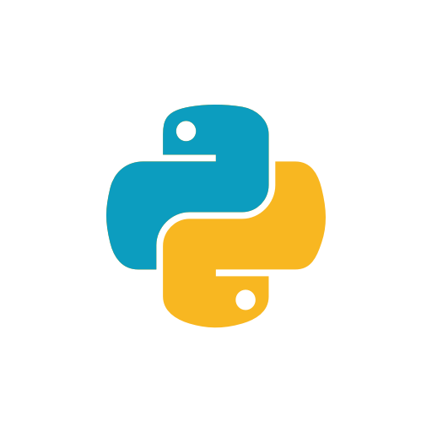
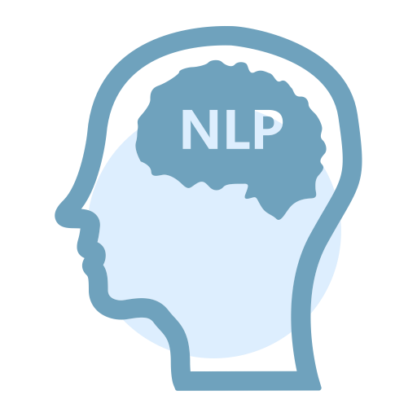

Technologies to be used
Nishshanka N.A.B.D

Slide 30
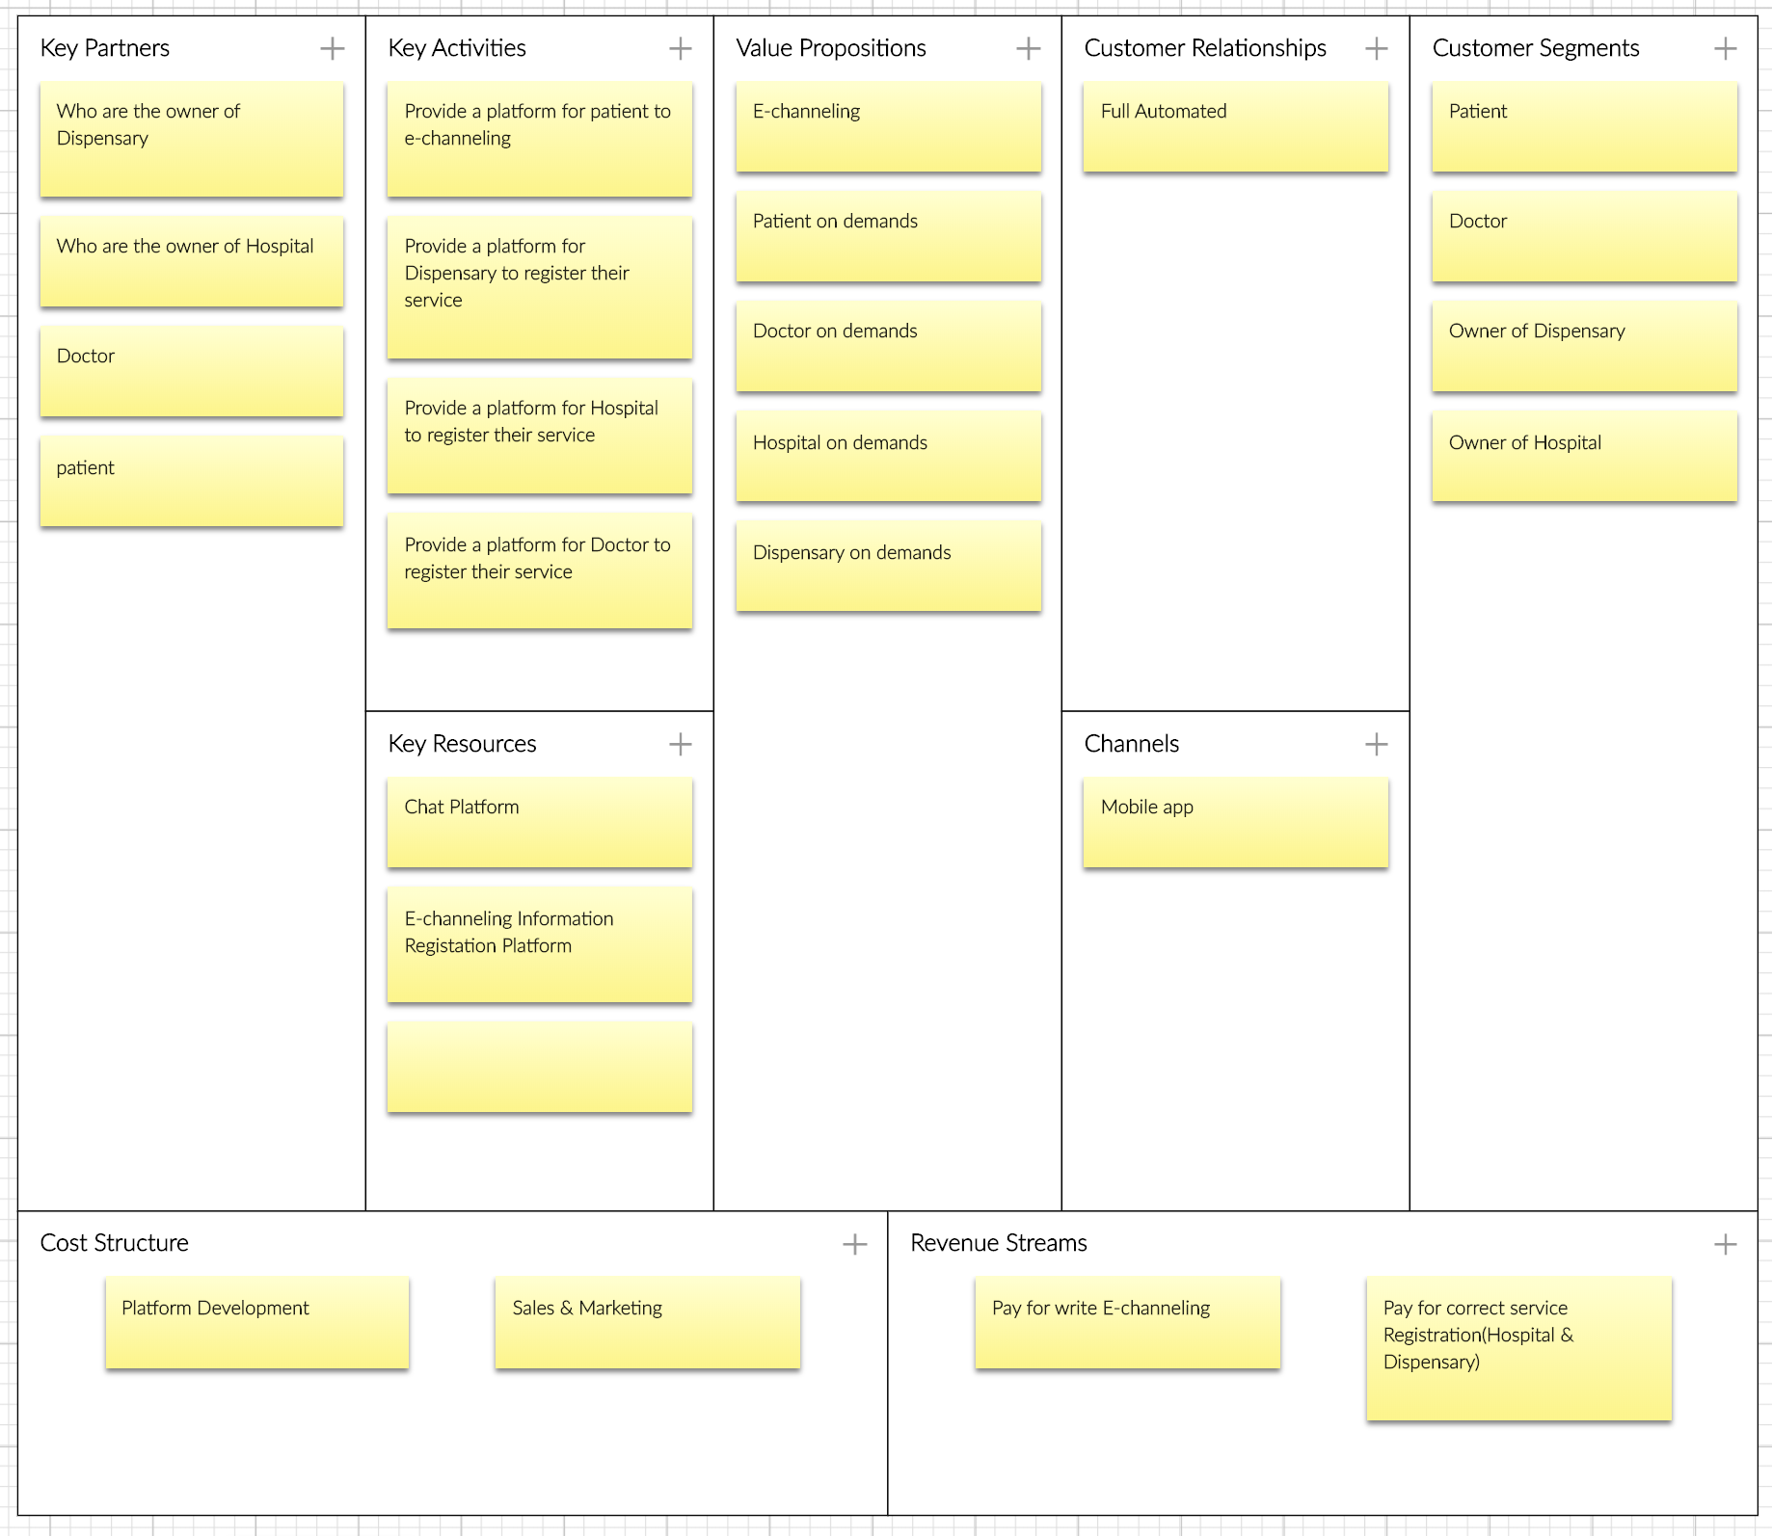
Business Model
Nishshanka N.A.B.D

Slide 31
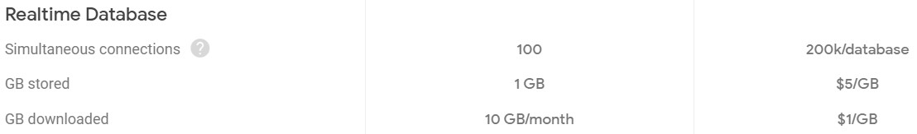
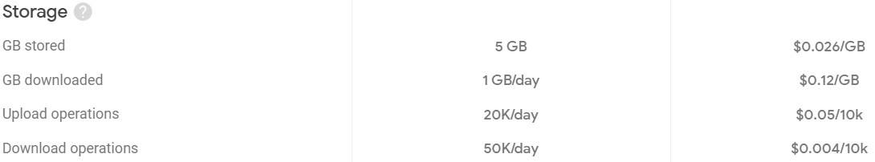
Budget
Nishshanka N.A.B.D
Firebase Realtime-Database :
Firebase Cloud Storage :
Total Amount $6.2

Slide 32
References
[1] | A. F. Miranda, "NVIDIA Developer Blog," nvidia, 19 December 2019. [Online]. Available: https://devblogs.nvidia.com/how-to-build-domain-specific-automatic-speech-recognition-models-on-gpus/​. [Accessed 26 January 2020].
[2] | W. Manamperi, "Sinhala Speech Recognition for Interactive Voice Response Systems Accessed Through Mobile Phones," University of Moratuwa, May 2018. [Online]. Available: https://www.researchgate.net/publication/327517552_Sinhala_Speech_Recognition_for_Interactive_Voice_Response_Systems_Accessed_Through_Mobile_Phones​. [Accessed 20 January 2020].
[3] | S. Palihakkara, "semanticscholar," University of Moratuwa, 2013. [Online]. Available: https://pdfs.semanticscholar.org/ec7d/90a15b08aee7d66d902e95c86824c2544a12.pdf?_ga=2.116270148.334219768.1580010100-1805892879.1580010100. [Accessed 15 January 2020].
[4] | C. Segura, "researchgate," Telefónica I+D, May 2018. [Online]. Available: https://www.researchgate.net/publication/327426302_Chatbol_a_chatbot_for_the_Spanish_La_Liga. [Accessed January 2020].

Slide 33
[5] | M. sarma, "academia.edu," Ramaiah University, December 2018. [Online]. Available: https://www.academia.edu/39258471/Diabot_A_Predictive_Medical_Chatbot_using_Ensemble_Learning. [Accessed January 2020].
[6] | N. d. Silva, "arxiv," 13 January 2020. [Online]. Available: https://arxiv.org/pdf/1906.02358.pdf. [Accessed 26 January 2020].
[7] | G. Leeming, "US National Library of Medicine," University of Manchester, 24 July 2019. [Online]. Available: https://www.ncbi.nlm.nih.gov/pmc/articles/PMC6668357/. [Accessed 25 January 2020].
[8] | Y. LeCun, "Stanford Vision and Learning Lab," Stanford Vision and Learning Lab, November 1998. [Online]. Available: http://vision.stanford.edu/cs598_spring07/papers/Lecun98.pdf. [Accessed January 2020].

Slide 34

Thank You..

